Slide 1
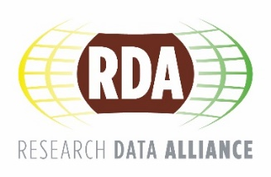
Research Data Alliance In a nutshell Source: https://rd-alliance.org/sites/default/files/attachment/RDA_in_a_nutshell_July2016.pptx 13 July 2016 Fotis Karayannis, RDA Secretariat Athena Research Center

Slide 2
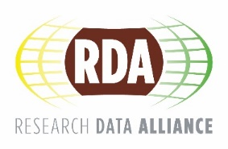
What is RDA?
RDA is an international effort focused on the development of a community and services that reduce barriers to data sharing and exchange, and the acceleration of data-driven innovation worldwide. With more than 4,100 members globally representing more than 110 countries, RDA includes data science professionals with different backgrounds and from multiple disciplines, coming among others from academia, research centres, libraries and industry.
Mission: RDA is building the social and technical bridges that enable open sharing of data
Vision: Researchers and innovators openly sharing data across technologies, disciplines, and countries to address the grand challenges of society.
(resources, environment, climate,
https://rd-alliance.org/sites/default/files/attachment/RDA_in_a_nutshell_July2016.pptx
www.rd-alliance.org/about-rda

Slide 3
What does RDA do?
Members come together through self-formed, volunteer, focused Working Groups, exploratory Interest Groups to exchange knowledge, share discoveries, discuss barriers and potential solutions, explore and define policies and test as well as harmonise standards to enhance and facilitate global data sharing.
RDA members collaborate together regionally and with the global RDA community to tackle numerous infrastructure challenges related to:
Reproducibility
Data preservation
Best practices for domain repositories
Curriculum development
Data citation
Data type registries
Metadata
and so many more!
www.rd-alliance.org/about-rda

Slide 4
Who Can Join RDA?
Any individual, regardless of profession or discipline, with an interest in reducing the barriers to data sharing and exchange and who agrees to RDA’s guiding principles of:
Openness
Consensus
Balance
Harmonization
Community-driven
Non-profit and technology-neutral
Membership is free @ http://www.rd-alliance.org/user/register
Organisations can also join RDA with a fee
https://rd-alliance.org/organisation/rda-organisation-affiliate-members/rda-organisational-membership.html
www.rd-alliance.org/about-rda

Slide 5
Getting involved
Individuals
Observers
Contributors
Drivers
Organisations
Insight
Adopt
Drive
National level
Coordination & Knowledge Exchange, Strategy & / or Implementation
Members
WGs-IGs-BoFs
Requests for Comments
Plenaries
Member
WGs-IGs-BoFs
RfCs
H2020 projects
Adoption / Uptake
Papers & Events
Meetings & Fora
Training & Workshops
Uptake pilots
www.rd-alliance.org/get-involved.html

Slide 6
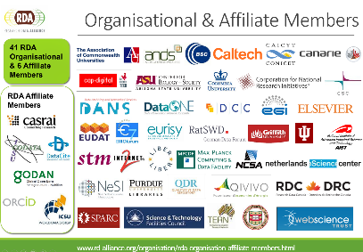
Why Join RDA?
Individual RDA Member Benefits
Contribute to acceleration of data infrastructure development
Work and share experiences with collaborators throughout the world
Access to extraordinary network of colleagues with various levels of experience, perspectives and practices
Gain greater expertise in data science regardless of whether one is a student, early or seasoned career professional
Enhance the quality and effectiveness of personal work and activities
Improve one’s competitive advantage professionally and positioning oneself for leadership within the broader research community
Organizational RDA Member Benefits
Provide an organizational perspective on the work of RDA and ability to influence RDA’s direction
Assist in implementation of RDA Outputs
Participate in all RDA Organizational Forums
Receive regular updates on the work of the RDA
Attend Organizational Assembly meetings and vote on proposed policies for consideration by the RDA Council and for members of the Organizational Advisory Board
Provide advice to the Council through the Organizational Advisory Board
Be recognized on the RDA Website and at RDA Meetings as a supporter of data interoperability
www.rd-alliance.org/get-involved.html

Slide 7
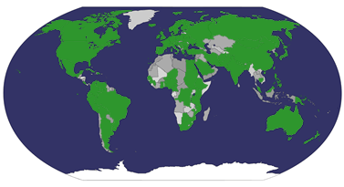
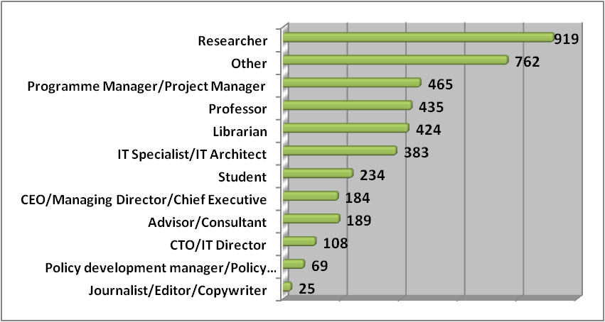
Type | Members (July 2016)
Press & Media | 27
Policy/Funding Agency | 62
Large Enterprise | 94
IT Consultancy/Development | 134
Small and Medium Enterprise | 240
Other | 228
Government/Public Services | 657
Academia/Research | 2755
TOTAL | 4197
Who is RDA?
from 111 countries
Total RDA Community Members: 4197
www.rd-alliance.org/about-rda

Slide 8
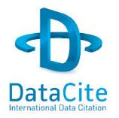
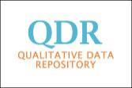
Organisational & Affiliate Members
41 RDA Organisational & 6 Affiliate Members
RDA Affiliate Members
www.rd-alliance.org/organisation/rda-organisation-affiliate-members.html
Notes:
Guiding Principles:
Openness
Consensus
Balance
Harmonization
Community-driven
Non-profit and technology-neutral

Slide 9
RDA Interest (IG) & Working Groups (WG) by Focus (1)
Domain Science - focused
Agrisemantics WG
BioSharing Registry: connecting data policies, standards & databases in life sciences WG
Rice Data Interoperability WG
Wheat Data Interoperability WG
Agriculture Data IG (IGAD)
Biodiversity Data Integration IG
Chemistry Research Data IG
Digital Practices in History and Ethnography IG
Geospatial IG
Global Water Information IG
Health Data IG
Marine Data Harmonization IG
Metabolomics Data Interoperability IG
Quality of Urban Life IG
RDA/CODATA Materials Data, Infrastructure & Interoperability
Research data needs of the Photon and Neutron Science community IG
Structural Biology IG
Community Needs - focused
RDA/CODATA Summer Schools in Data Science and Cloud Computing in the Developing World WG
Archives & Records Professionals for Research Data IG
Data for Development IG
Development of Cloud Computing Capacity and Education in Developing World Research IG
Education and Training on handling of research data IG
Engagement IG
Ethics and Social Aspects of Data IG
Total 73 groups: 27 Working Groups & 46 Interest Groups
www.rd-alliance.org/groups

Slide 10
RDA Interest (IG) & Working Groups (WG) by Focus (2)
Reference and Sharing - focused
Data Citation WG
Data Description Registry Interoperability WG
Data Security and Trust WG
Empirical Humanities Metadata WG
RDA / WDS Publishing Data Bibliometrics WG
Research Data Collections WG
QoS-DataLC Definitions WG
International Materials Resource Registries WG
National Data Services IG
RDA/CODATA Legal Interoperability IG
Reproducibility IG
New Paradigms for Data Discovery
Partnership Groups
RDA / TDWG Metadata Standards for attribution of physical and digital collections stewardship
RDA/NISO Privacy Implications of Research Data Sets WG
Repository Audit and Certification DSA–WDS Partnership WG
RDA/WDS Publishing Data IG
ELIXIR Bridging Force IG
Total 73 groups: 27 Working Groups & 46 Interest Groups
www.rd-alliance.org/groups

Slide 11
RDA Interest (IG) & Working Groups (WG) by Focus (3)
Data Stewardship and Services – focused
Brokering Framework WG
Brokering Governance WG
RDA / WDS Publishing Data Services WG
RDA / WDS Publishing Data Workflows WG
Active Data Management Plans IG
Data in Context IG
Data Rescue IG
Domain Repositories IG
Libraries for Research Data IG
Long tail of research data IG
Preservation e-Infrastructure IG
RDA/WDS Certification of Digital Repositories IG
RDA/WDS Publishing Data Cost Recovery for Data Centres IG
Repository Platforms for Research Data IG
Research Data Provenance IG
Virtual Research Environments IG
Base Infrastructure – focused
Array Database WG
Data Foundation and Terminology WG
Data Type Registries WG
Metadata Standards Catalog WG
Metadata Standards Directory WG
PID Information Types WG
Practical Policy WG
Data Fabric IG
Data Foundations and Terminology IG
Data in Context IG
Big Data IG
Brokering IG
Federated Identity Management IG
Metadata IG
PID IG
Service Management IG
Vocabulary Services IG
Total 73 groups: 27 Working Groups & 45 Interest Groups
www.rd-alliance.org/groups

Slide 12
RDA Recommendations & Outputs
THE RDA OUTCOMES LEGEND
Recommendations: are as currently defined and should be presented as the flagship outputs of RDA. We should specifically use the word RECOMMENDATION. They are RDA’s equivalent of the “specifications” or “standards” that other organisations create and endorse. The process for creating and endorsing these is already defined.
Supporting Outputs: are the outputs of RDA WGs and IGs that are fruit of RDA work, but may not be directly adoptable. “Upon request”, these sort of outputs go through a community comment period and if no major objections or gaps are identified they get the RDA Brand.
Other Outputs: include workshop reports, published articles, survey results, etc. Anything a WG or IG wants to register and report. Upon request, these are published and discoverable on the RDA website but have no level of endorsement.
www.rd-alliance.org/recommendaions-outputs

Slide 13
RDA Recommendations & Outputs
Data Foundation & Terminology: a model for data in the registered domain.
PID Information Types: a common protocol for providers and users of persistent ID services worldwide.
Data Type Registries: allowing humans and machines to act on unknown, but registered, data types.
Practical Policy: defining best practices of how to deal with data automatically and in a documented way with computer actionable policy.
www.rd-alliance.org/recommendaions-outputs

Slide 14
RDA Recommendations & Outputs
Metadata standards directory: Community curated standards catalogue for metadata interoperability
Data Citation: defining mechanisms to reliably cite dynamic data
Data Description Registry Interoperability solutions enabling cross platform discovery based on existing open protocols and standards
Wheat Data Interoperability impacting the discoverability, reusability and interoperability of wheat data by building a common framework for describing, representing linking and publishing wheat data
www.rd-alliance.org/recommendaions-outputs

Slide 15
RDA Recommendations & Outputs
Repository Audit and Certification DSA–WDS: A convergent DSA-WDS certification standard to help eliminate duplication of effort, increase certification procedure coherence and compatibility thus benefitting researchers, data managers, librarians and scientific communities.
RDA/WDS Publishing Data Bibliometrics: improved research data metrics and corresponding services, with the final goal of increasing the overall availability and quality of citations and research data itself.
RDA/WDS Publishing Data Services: A universal interlinking service between data and the scientific literature.
RDA/WDS Publishing Data Workflows: enhance the possibilities for greater discoverability and a more efficient and reliable reuse of research data benefitting other stakeholders like publishers, libraries and data centres.
www.rd-alliance.org/recommendaions-outputs

Slide 16
Open Call for Supporting and Other RDA Outputs
If your group has produced something that you would like to share with the broader community, please send it to enquiries@rd-alliance.org and indicate whether you would like it to be considered as a ‘Supporting’ or ‘Other’ output.
https://rd-alliance.org/call-supporting-and-other-rda-outputs

Slide 17
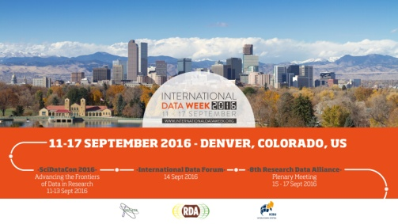
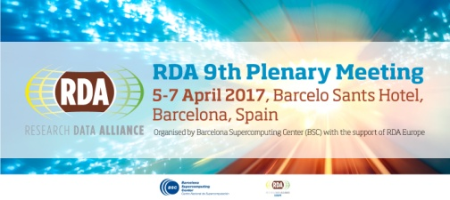
RDA Plenaries
RDA Plenary 8 during International Data Week 2016
When? 11-17 September 2016
Where? Denver, Colorado, USA
Co-located with? SciDataCon2016
Why attend?
Working Meeting: Updates & Progress
Knowledge Exchange, Networking & Direct Interaction
Best Practice, Outputs & Adoption
New ideas, groups, ….
RDA Plenary 9
When? 5-7 April 2017
Where? Barcelona, Spain
www.rd-alliance.org/plenaries

Slide 18
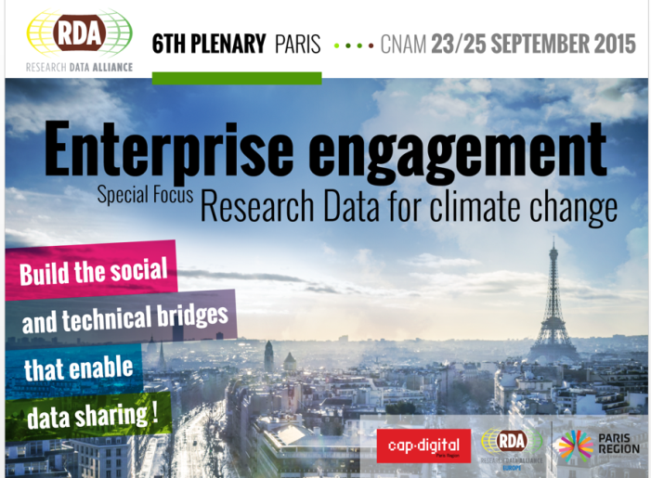
RDA Plenary 6 (Paris) – 23- 25 Sept 2015
RDA deliverables presented:
Repository Audit and Certification DSA–WDS
RDA/WDS Publishing Data Bibliometrics
RDA/WDS Publishing Data Services
RDA/WDS Publishing Data Workflows
7 Adoption cases: Deep Carbon Observatory, Platform for Experimental Collaborative Ethnography, Datafed.net, the Materials Innovation Infrastructure, EUDAT Collaborative Data Infrastructure, German Climate Computing Center (DKRZ) & Common Language Resources and Technology Infrastructure (CLARIN)
Focus on enterprise & climate change:
20 enterprises showcased solutions
3 climate change data challenge winners – Biovel, Plume Labs, Vizonomy
Focus on emerging professionals :
RDA/EU sponsored 12 European Early Career Researchers and Scientists & RDA/US sponsored 8 Fellowship winners
Theme: “Enterprise Engagement with a focus on Climate Change”
700 attendees from 40+ countries & hosted by Cap Digital – France
Co-located conferences:
eInfrastructures & RDA for Data Intensive Science
Persistent Identifiers: Enabling Services for Data Intensive Research
www.rd-alliance.org/plenaries/rda-sixth-plenary-meeting-paris-france

Slide 19
7 RDA Recommendations/outputs presented:
Repository Audit and Certification DSA–WDS
RDA/WDS Publishing Data Bibliometrics
RDA/WDS Publishing Data Services
RDA/WDS Publishing Data Workflows
Wheat Data Interoperability Recommendations
RDA/CODATA Summer Schools in Data Science and Cloud Computing in the Developing World Interim Recommendations
Brokering Governance Interim Recommendations
11 adoption presentations
30 international speakers over 5 plenary sessions
7 outputs & 11 adoption cases
8 Working Group meetings
25 Interest Group meetings
10 Birds of a Feather
9 Joint meetings
2 Organisational Member meetings
RDA for Newcomers Meeting
357 attendees from 33 countries
www.rd-alliance.org/plenaries/rda-seventh-plenary-meeting-tokyo-japan

Slide 20
Looking forward to seeing you ALL there

Slide 21
https://rd-alliance.org/plenary-meetings/rda-ninth-plenary-meeting.html

Slide 22
RDA in a Nutshell www.rd-alliance.org/ @resdatall
RDA Global
Email - enquiries@rd-alliance.org
Web - www.rd-alliance.org
Twitter - @resdatall
LinkedIn - www.linkedin.com/in/ResearchDataAlliance
Slideshare - http://www.slideshare.net/ResearchDataAlliance
Facebook - https://www.facebook.com/pages/Research-Data-Alliance/459608890798924
RDA Europe
Email - info@europe.rd-alliance.org
Web - europe.rd-alliance.org
Twitter - @RDA_Europe
RDA US
Twitter - @RDA_US

